Slide 1
Financial Globalization
Dr. J.D. Han
King’s College, UWO

Slide 2
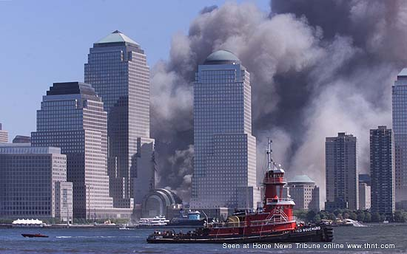
Photo: September 11, 2001, Lower Manhattan New York City
Why WTCs?
What is the target?
Who are the attackers?

Slide 3
1. Introduction
1) Definition of Globalization:
“a process which involves growing economic competition, openness and interdependence of countries worldwide”
2) Globalization presents Opportunities and Challenges
-> competition may lead to efficiency, but also may cause strife; beget winner/looser, and breed economic inequality
-> openness may lead to risk of vulnerability to external shocks
-> Interdependence may turn into contagion effect

Slide 4
2. Globalization of International Economy:
Globalization of Production versus Globalization of Finance
Trade and Production
- GATT, WTO have reduced barriers to international trade.
- Mulinational Corporations reduce production costs through foreign direct investment: intra-firm trade across countries but between affiliates of the same firm.
Finance
Consists of
- Financial transactions to back up international trade
-> growing in line with International Trade;
and
- International Investment independent of international trade
-> growing much faster than International Trade

Slide 5
International Investment
The other side of Corporate Financing;
Direct Investment vs Indirect Investment through Financial Intermediaries;
Takes 3 forms:
(1) Bank Loans
(2) Marketable Securities or Portfolio Investment (bonds, and equities)
(3) Foreign Direct Investment

Slide 6
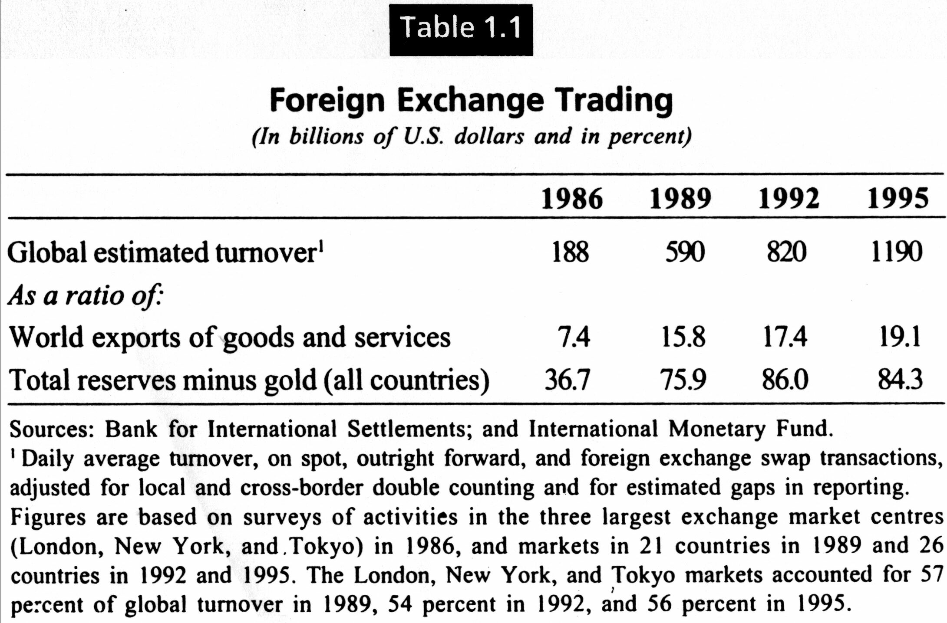
Data 1. Current State of International Finance:
Finance on its Own

Slide 7
Comments:
1) A large part of FOREX trading is now independent of international trade
2) Besides currency trade, new financial instruments, such as bonds, mutual funds, and derivatives have contributed to globalization of finance
3) These international financial flows are becoming liquid and attracted by short-term speculative gains

Slide 8
3. Trends of Global Financial Flows of International Investment
1) Mostly Private Capital Flows
2) Highly Concentrated
(1) Recipients
Not all countries have got capital inflows/investments
(2) Financial Intermediaries
A few ‘Big Hands’
3) Changing Characteristics: Getting “Hot”
Portfolio Investment
4) Innovations in Products and Techniques

Slide 9
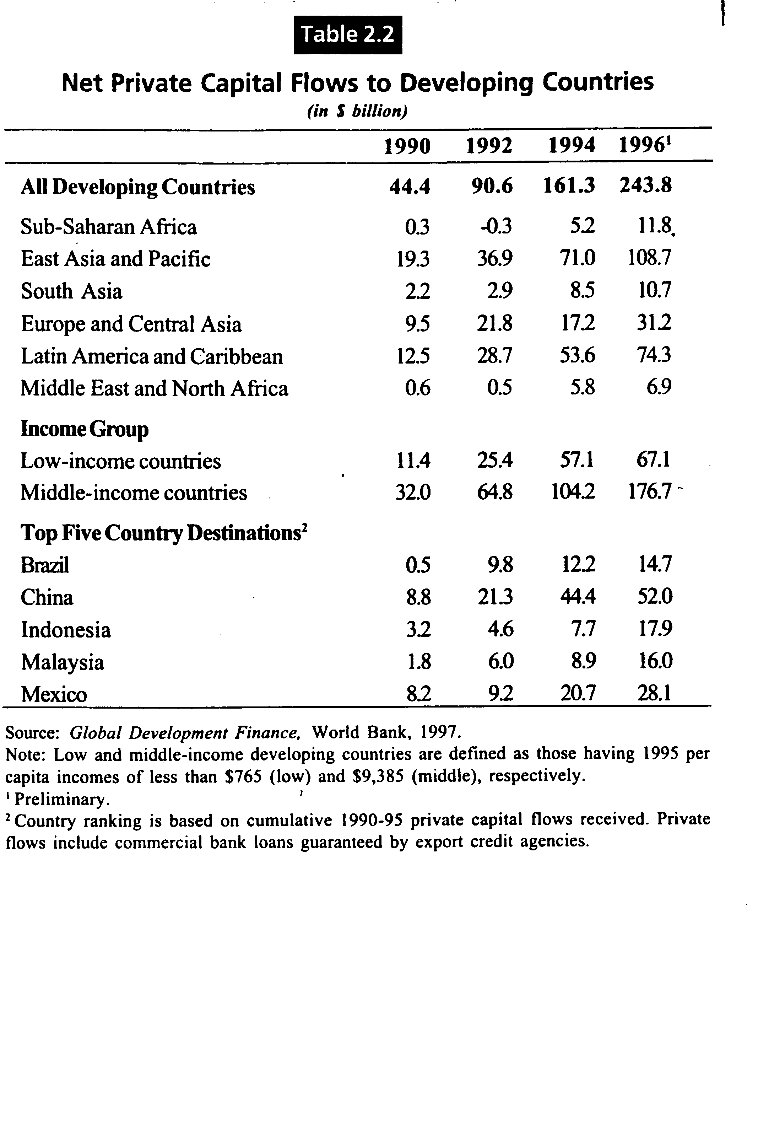
Data 2. Who gets International Capital Flows?

Slide 10
Updated Statistics of International Capital Flows
from the Word Bank
http://www.worldbank.org/prospects/gdf2000/slides/gdf002-6novoice/sld001.htm
Click the above and review the slides

Slide 11
Data 3. What are the ‘Big Hands’ that intermediate global capital flows?
(1) Bank Loans: World Top 50 banks
(2) Portfolio Investment
Investment Banks
Buying and selling international portfolios
-> Merrill Lynch, Morgan Stanley, Goldman Sachs, Salomon Smith Barney, Credit Suisse First Boston, J P Morgan, Lehman Brothers, Bear Stearns, Pain
Wealth Managers
->UBS, Axa, Fidelity, Kampo, Barclay’s, Merrill Lynch, State Street Global Advisors,Capital Group, Zurich Financial Services
Insurance Companies
-> Allianz, Assicurazioni Generali, AXA, Nippon Life, ING, Prudential, Met Life
(3) Foreign Direct Investment
Multinational Enterprises

Slide 12
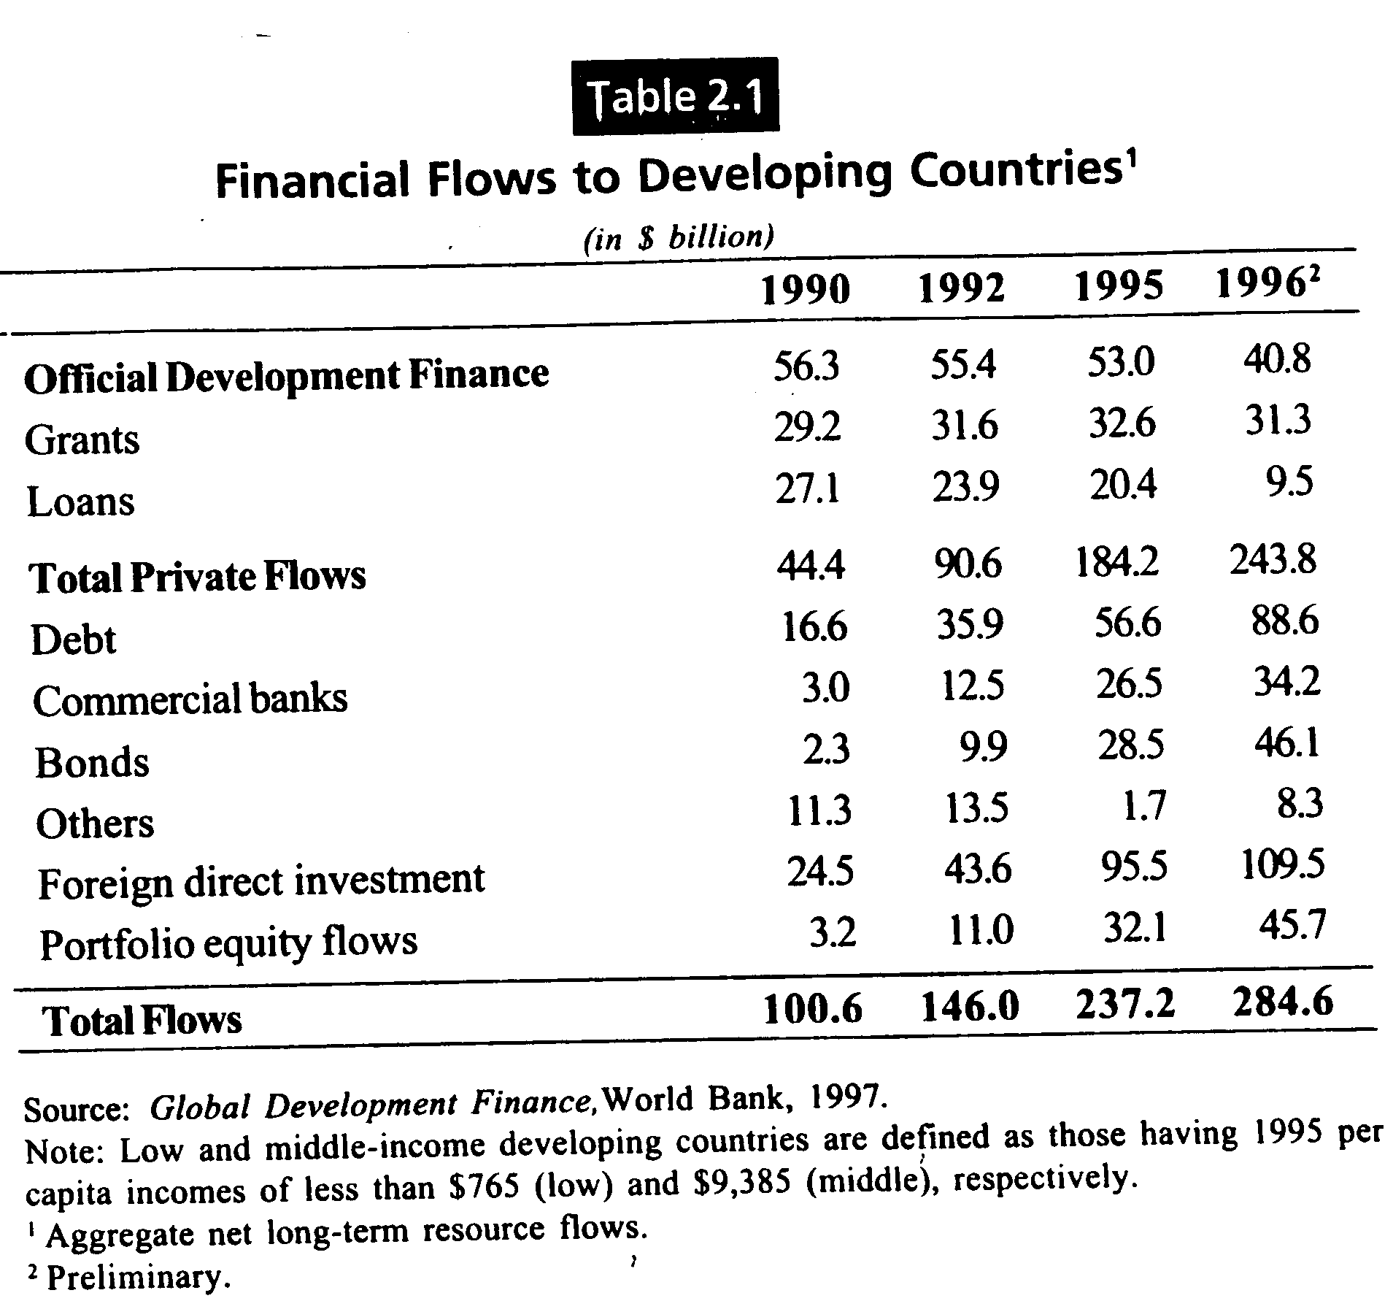
Data 4. Changing Formats of Global Capital Flows

Slide 13
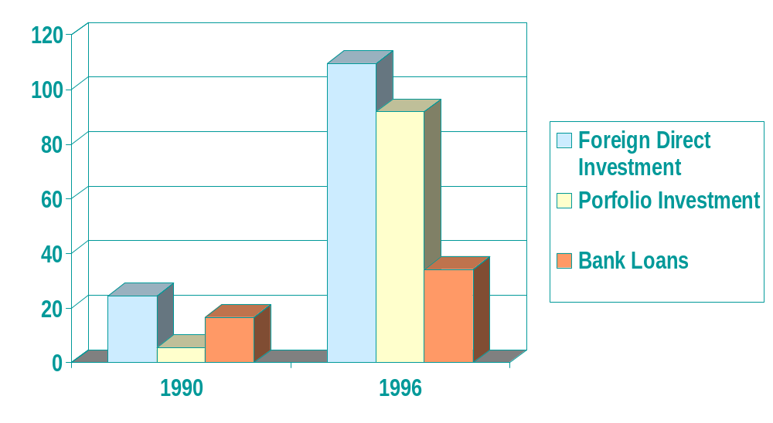
Data 4 b. Changing Compositions of
International Private Capital Flows to Developing Countries

Slide 14
Data 4 c. Comparison of Two Capital Flows
Foreign Direct Investment
- closely related to globalization of production
- mostly long-term
commitment and controls
Portfolio Investment
-motivated by financial gains
- mostly short-term highly liquid, speculative
-> source of ‘Hot Money’

Slide 15
4. Factors behind Surges in Portfolio Investment
1) A large amount of Accumulated Funds in Developed Countries
-Pension funds invested internationally increased from $302 billion in 1989 to $790 billion in 1994
2) Low Interest Rates in Developed Countries
-a successful monetary policy of inflation has lowered the inflation rate and the nominal interest rate.
-a convergence and capital saturation means a very low marginal product of capital and a low real interest rate.
3) Case for International Portfolio Diversification
-Can we benefit from even adding an international asset with a lower return and a higher risk to our existing portfolio?

Slide 16
4) Global Financial Liberalization has worked on Emerging Market
1970’s FOREX Market
-> IMF Article VIII: obligations of convertibility of currencies for current account transactions; accepted in 35 countries in 1970; 137 countries in 1997
1980’s Bond Market
-> 1980’s witnessed emergence of Samurai Bond, Shogun Bond, etc in Japan
Refer to a supplementary summary in this chapter
1990’s Equity Market
->WTO Agreement on Financial Services in 1991-93

Slide 17
5. Structure of International Financial Market
International Money Market: short-term financing
International Capital Market: long-term financing
International Bonds Market
International Equity Market
* Refer to my 1 page Summary!

Slide 18
6. Global Financial Liberalization
1) Promoted Globalization of Finance
2) International Landmark
(A series of)
WTO Agreement on Financial Services in 1990’s
By 1995, 35 developing countries have liberalized capital account transactions
In 1991. 26% of emerging stock markets allowed free entry for non-residents; in 1994, 58% have free entry

Slide 19
3) Financial Liberalization Gone Wrong:
Asian Financial Crisis
Background
(1) Investment exceeding Domestic Savings
-> Strong Economic Growth for the Last Two Decades
-> High External Liabilities; Debt Financing
(2) Hasty Financial Liberalization
->Wrong Sequencing of Liberalization
<-Right one starts from Consolidation, and moves to Domestic Financial Liberalization, and External Liberalization
(3) Trigger and Contagion Effect
Amid Information asymmetry - lagging financial infrastructure(system) - lack of transparency, a trigger led to herding behaviors by investors

Slide 20
*Tales of Two Examples: Korea and Taiwan-Taiwan did not have financial crisis
Korea
-Severe Financial Crisis
-Rapid Financial Liberalization
-Economy based on Conglomerates (Chaebol)
Taiwan
- Virtually no Financial Crisis
- Cautious Financial Liberalization
-Economy based on Medium-and Small-sized Firms

Slide 21
7. Globalization of Canadian Economy and Financial Industry
1)Overall Economy : Highly “Open”
->40% of GDP through international trade
2) Financial Industry: Highly Open Outbound, and Highly Protected Inbound
-> Foreign Banks being kept out or limited in business scopes
-> Schedule 2 banks performing poorly
-> WTO Agreements on Financial Services demanded Changes

Slide 22
3)Business Characteristics of Canadian Banking Industry
Expansion of International Operation
-> a substitute for highly regulated domestic financial market
Large Overseas Assets
Relatively Conservative Domestic Banking Practice
-> Bank Loans account for a smaller share of Corporate Funding Source.

Slide 23
4) “Opening up” of Canadian Financial/Banking Industry
Has Canada achieved a true sense of “International Financial Liberalization”?:
Bill C-67 coming into effect in 1999
-> Foreign banks can have a “full service” branch in Canada.
-> This branch cannot take deposits of $150K or less.
Domestic Competition and Consolidation are needed: The prerequisite for International Competition
Canadian Financial Sector Reform underway
->Bill C-38 and Bill C-8 in February 2001 may address some issues

Slide 24
* Canadian Bank M& A:
What goes around comes around
BOM and Royal Bank failed
-> Non economic factors prevailed
-> Against Global Trends
<- The same ‘visible’ hand that protects Canadian Banks from international competition stops Canadian Bank Mergers.

Slide 25
* Please, read the following Web page and tell me what you think:
Harris Bank of Chicago recently bought by BOM
“ We offer you a wide array of personal banking, investment, trust and financial planning services to help you manage your money, build your wealth and achieve your financial goals. Checking/Savings Brokerage Loans Private Bank Services mbanx online banking Mortgages Harris provides a broad range of corporate banking services to corporations, institutions, not-for-profit and government entities nationwide. We also provide banking, trust and investment services to small business throughout Chicago. Corporate & Institutional Banking Small Business Shareholder Services Corporate Trust Legal | Regulators Harris Bank is a member of the Bank of Montreal group of companies. MEMBER FDIC * NOT FDIC INSURED - NO BANK GUARANTEE - MAY LOSE VALUE
Thoughts:
1) Why would BOM do business in this rather adventurous fashion? If you are ignorant of BOM, you may think that BOM is a risk-taker.
2) Why does BOM exhibit different degrees of prudentiality between domestic and international operations?

Slide 26
5) Possible Gains or Loss for Canada from Globalized Financial Market?
Gains
- International Competition means More Choices for Consumers of Retail Banking Services
- Improved Corporate Financing
Losses
- Canadian Banks’ Small Asset-Size: good M & A- targets by International Financial Giants
- Spill-Over from Political Instability: Foreign Exchange Risks triggered by the threat of Quebec Separation<- a scary “Landry”

